Slide 1
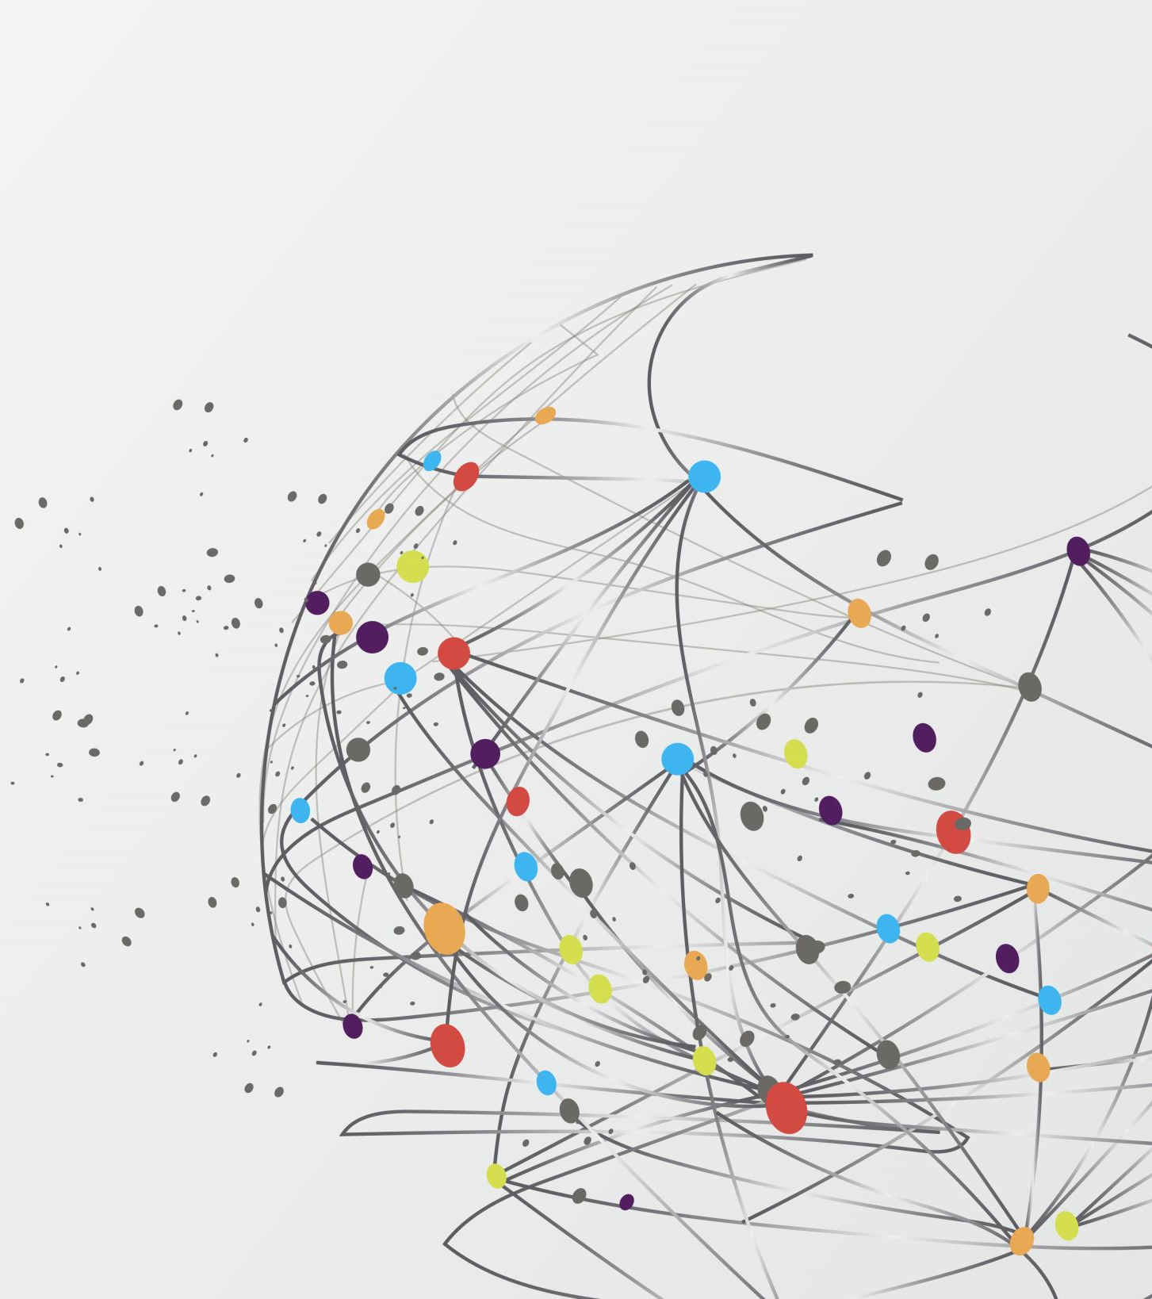
ARMY DRONE'S SURVEILING THE POPULACE
By Husnain, Hamza, Moasib
I did slides 1,3,5,7,10 you guys do other ones - Husnain​

Slide 2
Intro

Slide 3
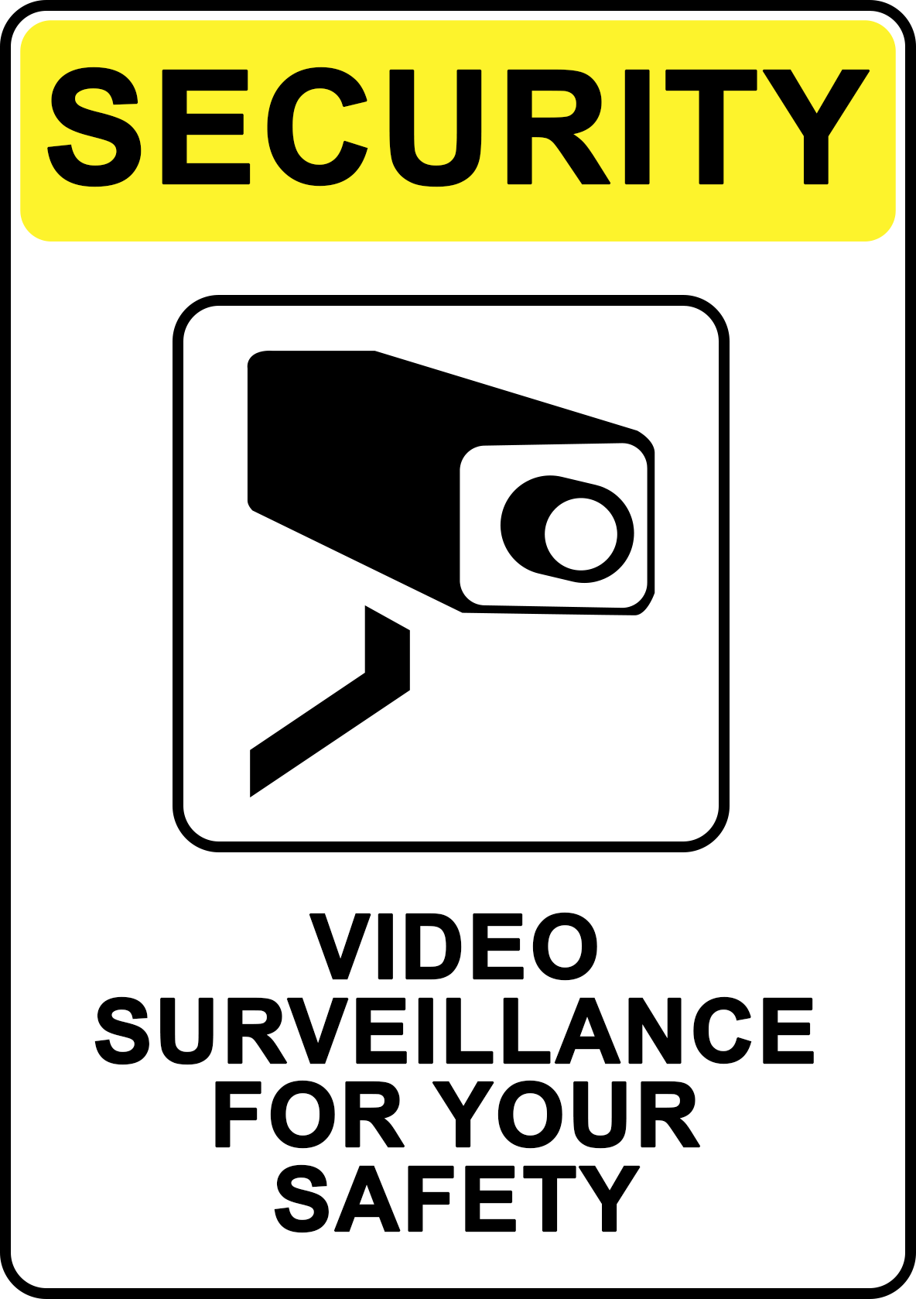
Pros - 1
Increased in safety for citizens
Keep dangerous criminals off the streets
Help optimise police activity (pollice won't be falsely called out to the wrong areas due to better info)

Slide 4
Pros - 2

Slide 5
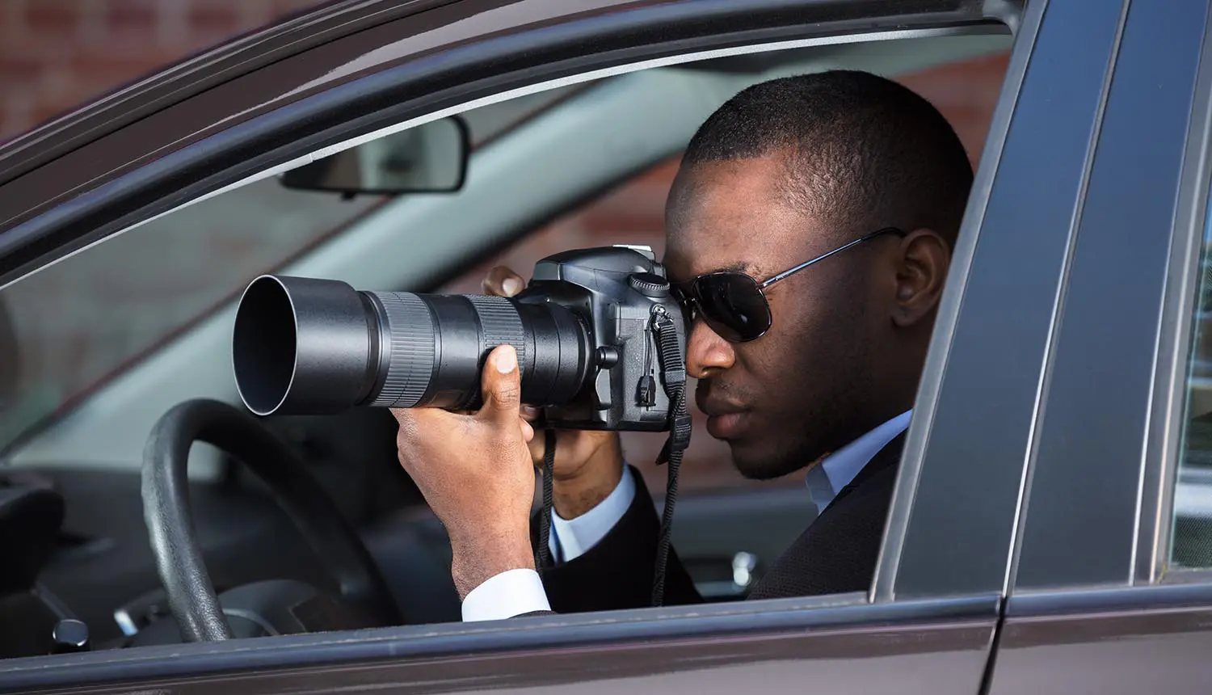
Cons - 1
This is a serious breach of people's privacy
Doppleganger's or similar looking people could cause false info to be given out
There's no guarantee only criminals will be spied on or if personal info will be leaked

Slide 6
Cons - 2

Slide 7
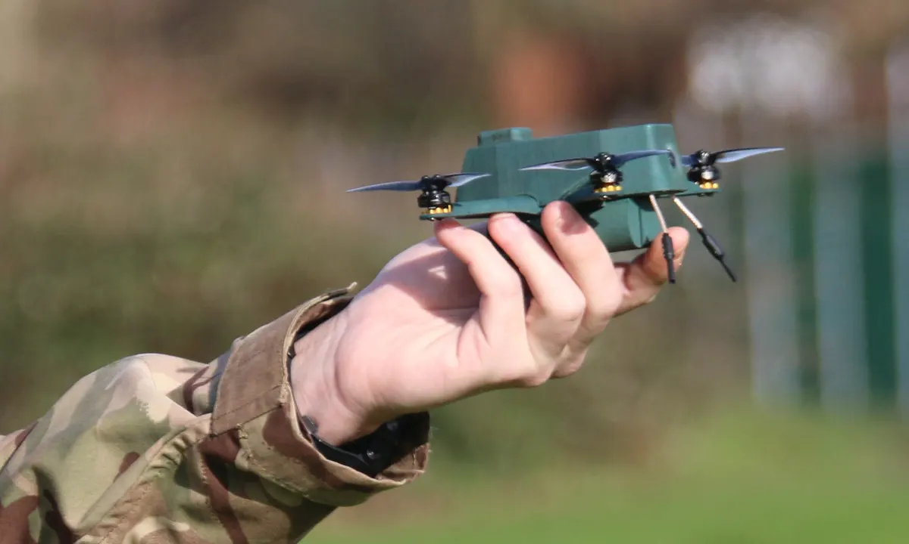
Examples - 1
The British army has bought 30 “nano 'Bug' drones” for soldiers to spy on targets up to 2km (1.25 miles) away, in the latest step in the military use of controversial unmanned aerial vehicles (UAVs). The drones are small enough to be held in the palm of one hand, and weigh 196g, about the same as a large smartphone.

Slide 8
Examples - 2

Slide 9
Conclusion

Slide 10



TY for being good children and listening

